Slide 1
Case study
for Electricity on Rwanda
EST 371
Chanhee Kim, Haejoon Lee,
Heejoon Hwang, Hyeonjun Hwang

Slide 2


Slide 3
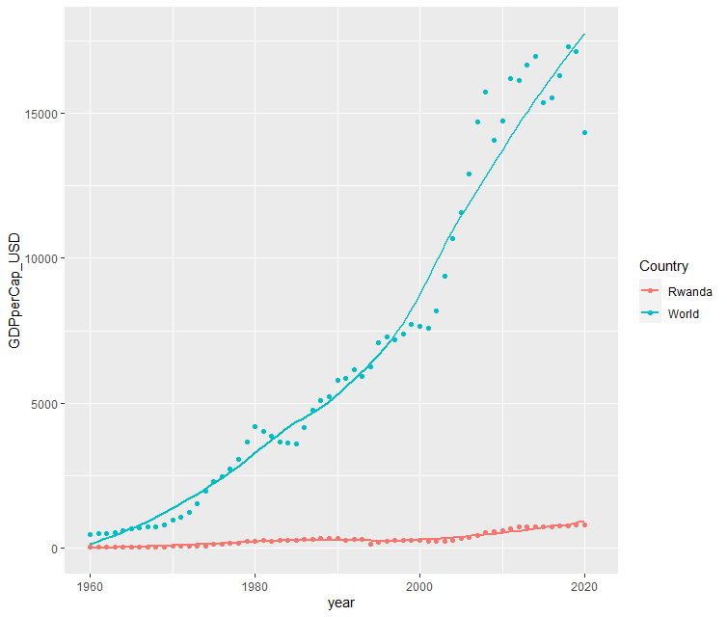
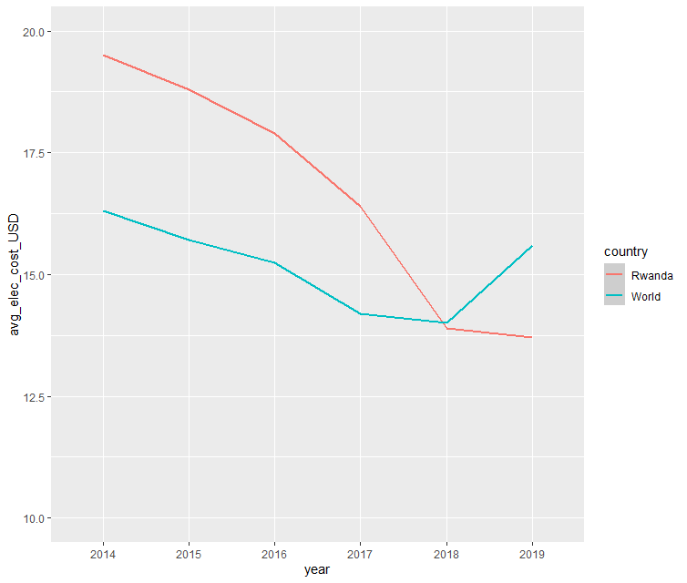
Problem / Visualization

Slide 4
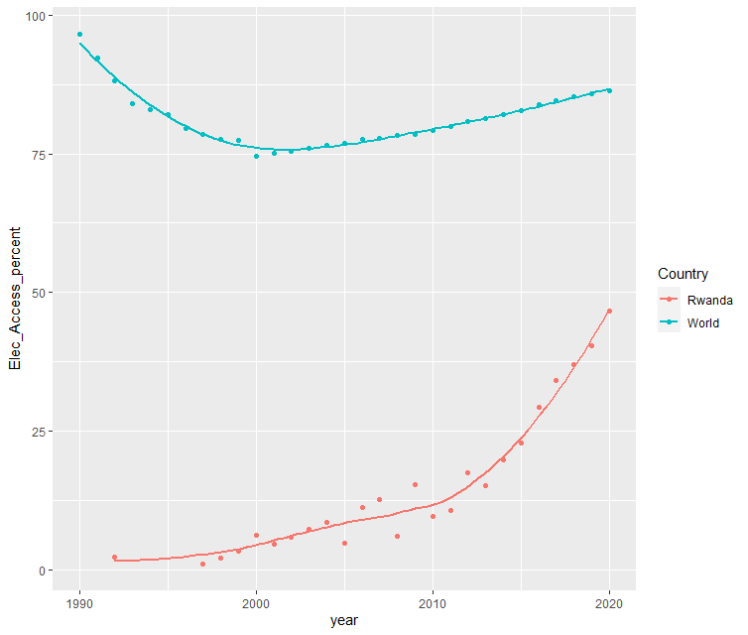
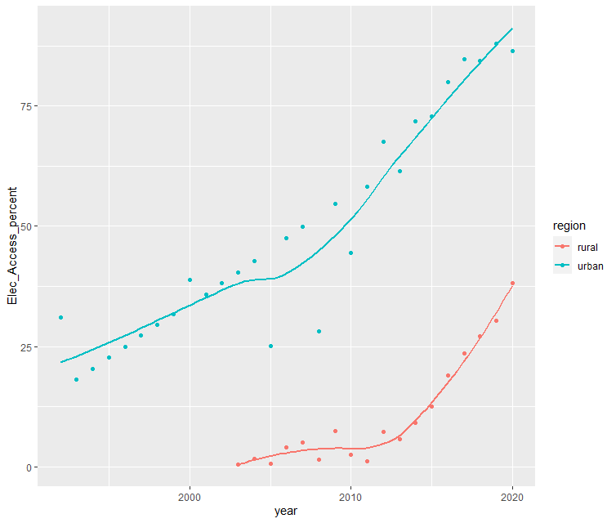
Problem / Visualization

Slide 5
SDGs

Slide 6


GOAL 7
759 M
¾

Slide 7


GOAL 11
1 B / 238 M

Slide 8

WHY SDGs?

Slide 9
City vs Rural

Slide 10
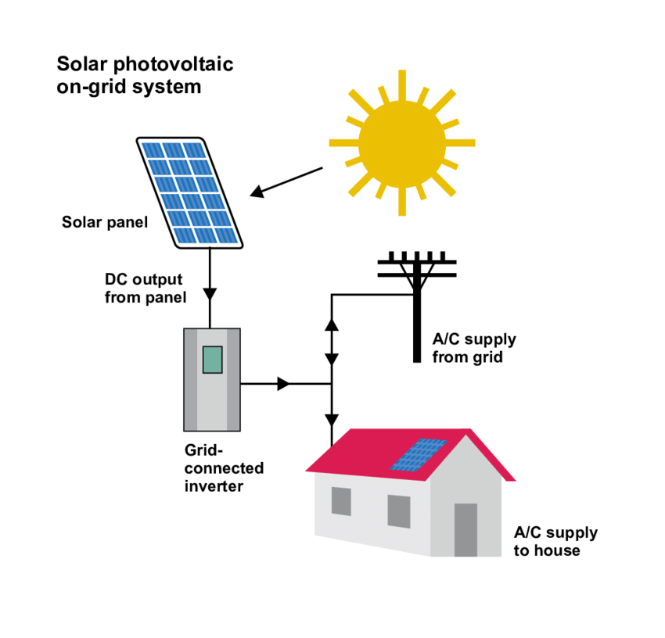
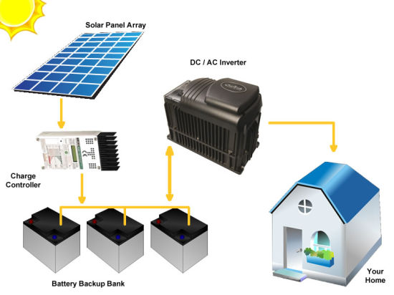
Solution (On grid vs Off grid)

Slide 11
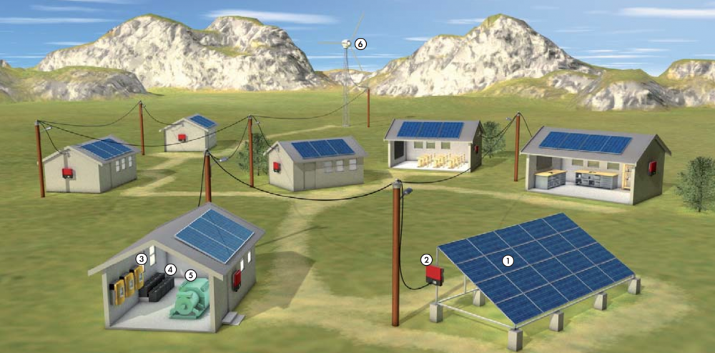
Solution (Mini-grid)

Slide 12
